Slide 1
Critical Incident Management
MN Chief’s of Police
Leadership Academy
August, 2015
Captain Greg Weiss

Slide 2
https://www.youtube.com/watch?v=qHM2rDrp-bw

Slide 3
Should Have Taken a Vacation Day
Initial Call?
Crowds
Communications
Transportation/Traffic Issues
YOU ARE “IT” UNTIL THE TROOPS ARRIVE

Slide 4
Firefighters Have Us On This One

Slide 5
Fire Service vs Law Enforcement
ICS and NIMS has been in use in the fire service for decades.
We use it every day
Standardizing is key
Law Enforcement Doesn’t Like:
“I’M IN COMMAND”
WHY?

Slide 6
N.I.M.S. & I.C.S.
National Incident Management System
Incident Command System
Get to know both because:
No longer can you just say “Sarge told me too” or “That’s above my paygrade”.

Slide 7
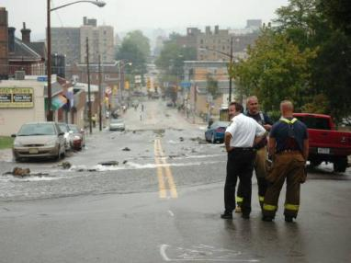
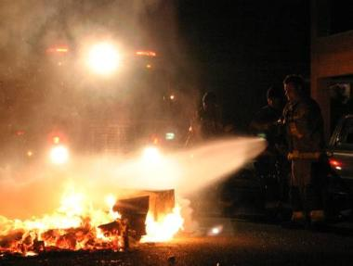
What Is an Incident?
An incident is . . .
an occurrence or event, natural or human-caused, that requires a response to protect life or property.

Slide 8
What Is NIMS?
Notes:
Tell the participants that this video provides an introduction to NIMS.
Instructions for playing the video: The videos are activated by a single click on the image in Slide Show mode. If you click a second time on the video, it will stop. The videos will not work unless you are in Slide Show mode.
Video Transcript: Each day communities respond to numerous emergencies. Most often, these incidents are managed effectively at the local level.
However, there are some incidents that may require a collaborative approach that includes personnel from:
Multiple jurisdictions,
A combination of specialties or disciplines,
Several levels of government,
Nongovernmental organizations, and
The private sector.
The National Incident Management System, or NIMS, provides the foundation needed to ensure that we can work together when our communities and the Nation need us the most.
NIMS integrates best practices into a comprehensive, standardized framework that is flexible enough to be applicable across the full spectrum of potential incidents, regardless of cause, size, location, or complexity.
Using NIMS allows us to work together to prepare for, prevent, respond to, recover from, and mitigate the effects of incidents. This course introduces you to the NIMS concepts, principles, and components.

Slide 9
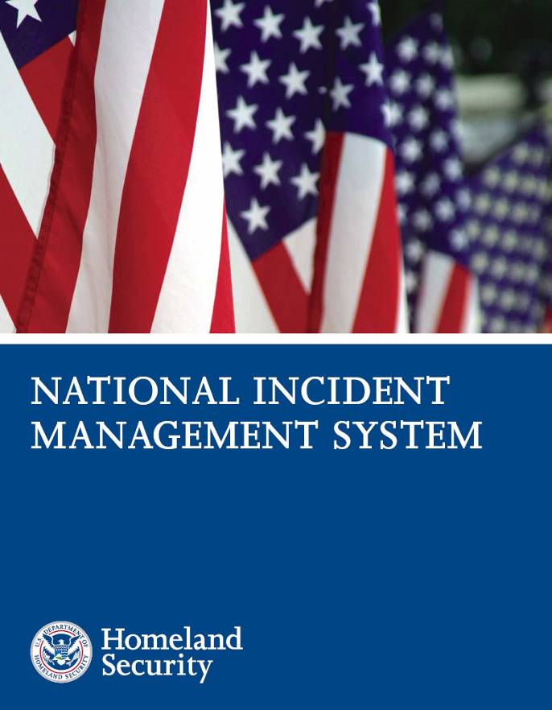
NIMS Overview
What ? . . . NIMS provides a consistent nationwide template . . .
Who? . . . to enable Federal, State, tribal, and local governments, the private sector, and nongovernmental organizations to work together . . .
How? . . . to prepare for, prevent, respond to, recover from, and mitigate the effects of incidents regardless of cause, size, location, or complexity . . .
Why? . . . in order to reduce the loss of life and property, and harm to the environment.
Notes:
Explain to the participants that the National Incident Management System (NIMS) provides a consistent framework for incident management at all jurisdictional levels regardless of the cause, size, or complexity of the incident. NIMS is not an operational incident management or resource allocation plan.
Tell the participants that the NIMS document was developed through a collaborative intergovernmental partnership with significant input from the incident management functional disciplines, nongovernmental organizations (NGOs), and the private sector.
Originally published on March 1, 2004, the NIMS document was revised in 2008 to reflect contributions from stakeholders and lessons learned during recent incidents.

Slide 10
NIMS: What It Is/What It’s Not
NIMS is . . .
A flexible framework of:
Doctrine
Concepts
Principles
Terminology
Organizational processes
Applicable to all hazards and jurisdictions
NIMS is not . . .
An operational incident management plan
A resource allocation plan
A terrorism/WMD-specific plan
Designed to address international events
Notes:
Refer the participant to items on the visual stating “What NIMS Is” and “What NIMS Is Not.” Read aloud the following situations (or other examples that would be relevant to the audience). Tell the participants to indicate if they are consistent or inconsistent with NIMS:
Local officials are using the Incident Command System (ICS) to plan for the upcoming Fourth of July celebration. Answer: Consistent With NIMS Explanation: NIMS encourages the use of ICS for both planned events and incidents.
A jurisdiction/agency follows NIMS only when incidents are complex enough to involve other jurisdictions. Answer: Not Consistent With NIMS Explanation: NIMS applies to all hazards independent of size or complexity.
An agency is replacing its operational plan for responding to incidents with the guidance provided in NIMS. Answer: Not Consistent With NIMS Explanation: NIMS provides overall response principles and structures but does not provide specific plans.
An organization is reorganizing and using NIMS/ICS titles for day-to-day routine activities. Answer: Not Consistent With NIMS Explanation: NIMS is designed to manage incidents rather than day-to-day business operations.

Slide 11
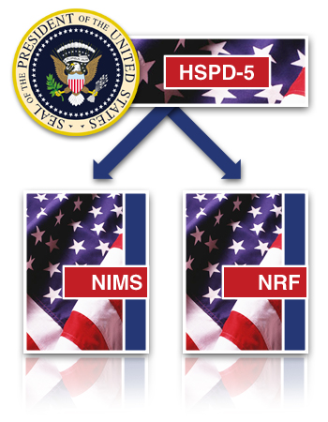
HSPD 5 Management of Domestic Incidents
Homeland Security Presidential Directive 5 (HSPD-5) directed the Secretary of Homeland Security to:
Develop and administer a National Incident Management System (NIMS).
Develop the National Response Framework (NRF).
Notes:
Explain that Homeland Security Presidential Directive 5 (HSPD-5), "Management of Domestic Incidents," directed the Secretary of Homeland Security to:
Develop and administer a National Incident Management System (NIMS).
Develop the National Response Framework (NRF).

Slide 12
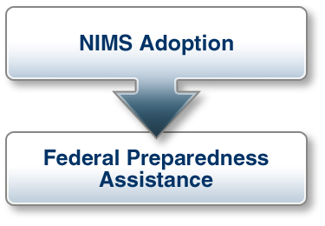
The NIMS Mandate
HSPD-5 requires all Federal departments and agencies to:
Adopt and use NIMS in incident management programs and activities.
Make adoption of NIMS a condition for Federal preparedness assistance (through grants, contracts, and other activities).
Notes:
Explain that HSPD-5 requires all Federal departments and agencies to:
Adopt NIMS and use it in their individual incident management programs and activities.
Make adoption of NIMS by State, tribal, and local organizations a condition for Federal preparedness assistance (through grants, contracts, and other activities).

Slide 13
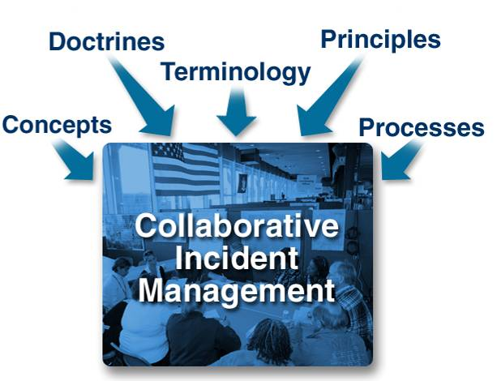
Collaborative Incident Management
NIMS:
Is not an operational incident management or resource allocation plan.
Represents a core set of doctrines, concepts, principles, terminology, and organizational processes
Enables effective, efficient, and collaborative incident management.
Notes:
Tell the participants that NIMS is not an operational incident management or resource allocation plan.
Explain that NIMS represents a core set of doctrines, concepts, principles, terminology, and organizational processes that enables effective, efficient, and collaborative incident management.

Slide 14
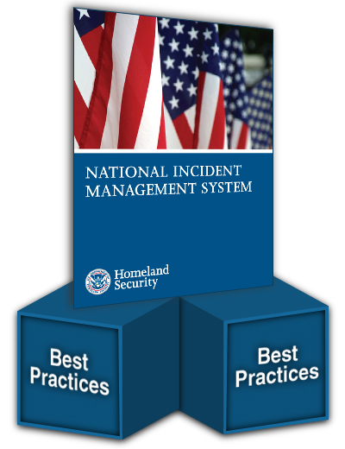
NIMS Builds on Best Practices
NIMS integrates emergency management best practices that:
Lay the groundwork for the components of NIMS.
Provide for the further development and refinement of supporting national standards, guidelines, protocols, systems, and technologies.
Notes:
Explain how, by building on the foundation provided by existing emergency management and incident response systems used by jurisdictions, organizations, and functional disciplines at all levels, NIMS integrates best practices into a comprehensive framework.
Tell the participants that these best practices lay the groundwork for the components of NIMS and provide the mechanisms for the further development and refinement of supporting national standards, guidelines, protocols, systems, and technologies.

Slide 15
NIMS Is Dynamic
NIMS:
Is not a static system.
Fosters the development of specialized technologies that facilitate response.
Allows for the adoption of new approaches that will enable continuous refinement of the system.
Notes:
Note that NIMS is not a static system.
Explain that NIMS fosters the development of specialized technologies that facilitate emergency management and incident response activities, and allows for the adoption of new approaches that will enable continuous refinement of the system over time.

Slide 16
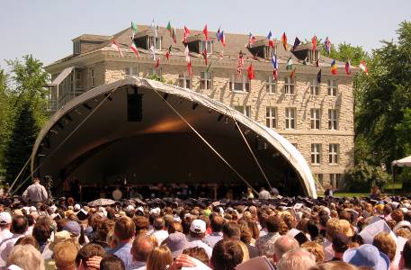
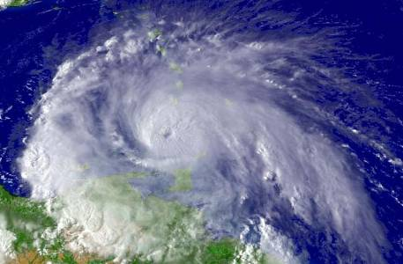
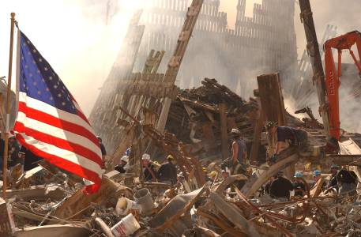
Flexibility
Planned Events
Forecasted Events
No-Notice Events
Notes:
Explain to the participants that the components of NIMS are adaptable and scalable to any situation, from routine, local incidents, to incidents requiring the activation of interstate mutual aid, to those requiring a coordinated Federal response. NIMS applies to all types of incidents.

Slide 17
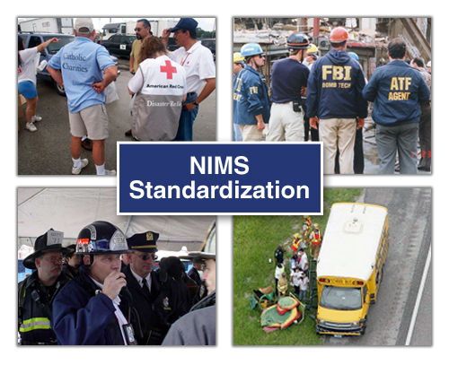
Standardization
Standardized organizational structures:
Improve integration and connectivity among jurisdictions and disciplines.
Allow those who adopt NIMS to work together.
Foster cohesion among various response organizations.
Notes:
Describe how NIMS provides a set of standardized organizational structures that improve integration and connectivity among jurisdictions and disciplines, starting with a common foundation of preparedness and planning.
Personnel and organizations that have adopted the common NIMS framework are able to work together, thereby fostering cohesion among the various organizations involved in all aspects of an incident.

Slide 18
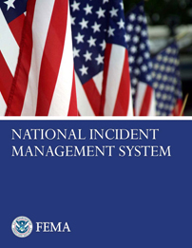
NIMS Components & ICS
Preparedness
Communications and Information Management
Incident Command System
Resource Management
Multiagency Coordination Systems
Command and Management
Ongoing Management and Maintenance
Public Information
Additional Information: www.fema.gov/emergency/nims

Slide 19
INCIDENT COMMAND SYSTEM

Slide 20
What Is ICS?
ICS:
Is a standardized, on-scene, all-hazards incident management concept.
Enables a coordinated response among various jurisdictions and agencies.
Establishes common processes for planning and management of resources.
Allows for integration within a common organizational structure.

Slide 21
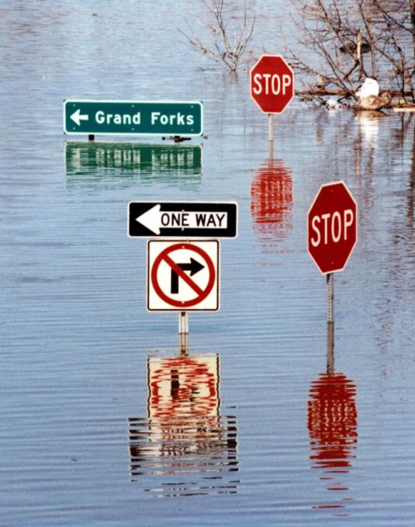
When Is ICS Used?
ICS can be used to manage:
Natural hazards.
Technological hazards.
Human-caused hazards.
Planned events.

Slide 22
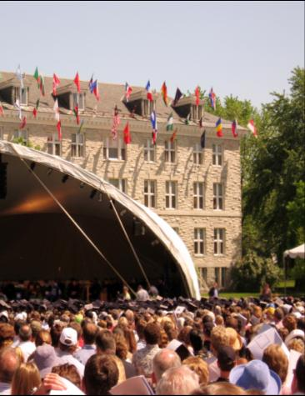
Why Use ICS?
1. It Works!
2. Mandates

Slide 23
Discussion Question
What are common causes of incident response problems?

Slide 24
Lessons Learned
Without ICS, incident responses typically:
Lack accountability.
Have poor communications.
Use unsystematic planning processes.
Are unable to efficiently integrate responders.

Slide 25
ICS Benefits
ICS helps to ensure:
The safety of responders, workers, and others.
The achievement of response objectives.
The efficient use of resources.

Slide 26
Common Terminology – No Codes!
Using common terminology helps define:
Organizational functions.
Incident facilities.
Resource descriptions.
Position titles.

Slide 27
Discussion Question
Why should you use plain English during an incident response?

Slide 28
Why Plain English?
EMT = Emergency Medical Treatment
EMT = Emergency Medical Technician
EMT = Emergency Management Team
EMT = Eastern Mediterranean Time (GMT+0200)
EMT = Effective Methods Team
EMT = Effects Management Tool
EMT = El Monte, CA (airport code)
EMT = Electron Microscope Tomography
EMT = Email Money Transfer

Slide 29
ICS Features: Overview
Standardization
Common terminology
Command
Establishment and transfer of command
Chain of command and unity of command
Planning/Organizational Structure
Management by objectives
Incident Action Plan (IAP)
Modular organization
Manageable span of control
Facilities and Resources
Comprehensive resource management
Incident locations and facilities
Communications/Information Management
Integrated communications
Information and intelligence management
Professionalism
Accountability
Dispatch/Deployment

Slide 30
Command: Definition
Command: The act of directing, ordering, or controlling, by virtue of explicit statutory, regulatory, or delegated authority.
At an incident scene, the Incident Commander has the authority to assume command!

Slide 31
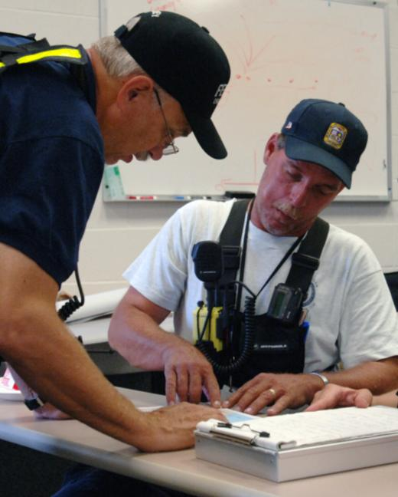
Transfer of Command
Moves the responsibility for command from one Incident Commander to another.
Must include a transfer of command briefing (which may be oral, written, or both).

Slide 32
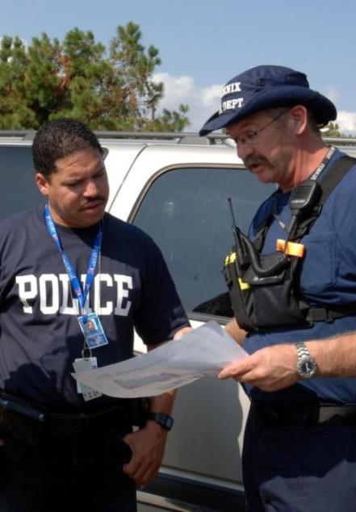
When Command Is Transferred
A more qualified Incident Commander arrives.
A jurisdiction or agency is legally required to take command.
Incident complexity changes.
The current Incident Commander needs to rest.

Slide 33
Discussion Question
What would you include in a transfer of command briefing?

Slide 34
Chain of Command
Chain of command:
Is an orderly line of authority within the response organization.
Allows incident managers to direct and control the actions of all personnel under their supervision.
Avoids confusion by requiring that orders flow from supervisors.
Does not prevent personnel from sharing information.

Slide 35
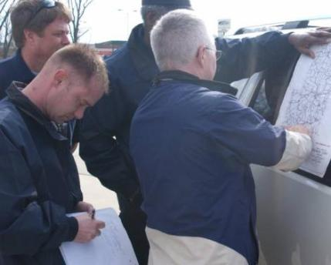
Unity of Command
Under unity of command, personnel:
Report to only one incident supervisor.
Receive work assignments only from the assigned supervisor.

Slide 36
Manageable Span of Control
Span of control:
Pertains to the number of individuals or resources that one supervisor can manage effectively during an incident.
Is key to effective and efficient incident management.
Supervisor
Resource 1
Resource 3
Resource 2

Slide 37
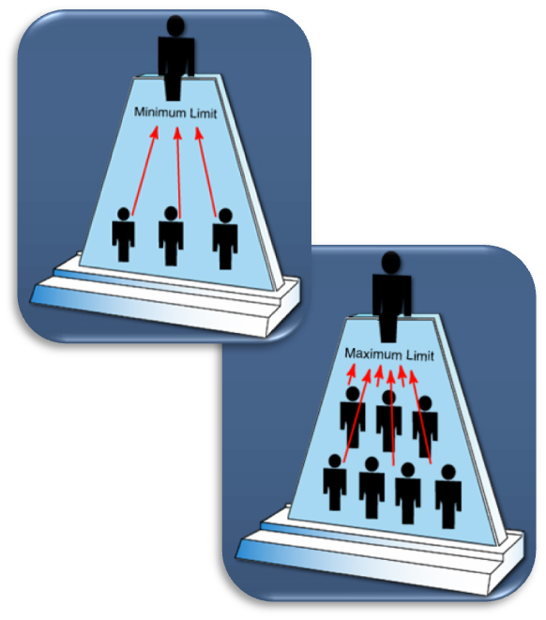
ICS Management: Span of Control
ICS span of control for any supervisor:
Is between 3 and 7 subordinates.
Optimally does not exceed 5 subordinates.

Slide 38
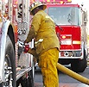
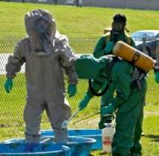
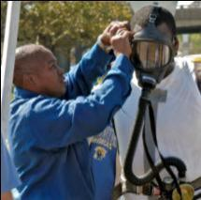
Unified Command
The Unified Command organization consists of the Incident Commanders from the various jurisdictions or organizations operating together to form a single command structure.
Fire & Rescue Incident Commander
Local Law Enforcement Incident Commander
HazMat Incident
Commander

Slide 39
Unified Command Benefits
A shared understanding of priorities and restrictions.
A single set of incident objectives.
Collaborative strategies.
Improved internal and external information flow.
Less duplication of efforts.
Better resource utilization.

Slide 40
Unified Command Features
A single integrated incident organization
Co-located (shared) facilities
One set of incident objectives, single planning process, and Incident Action Plan
Integrated General Staff – Only one Operations Section
Coordinated process for resource ordering

Slide 41
Possible Organization
Unified Command
HazMat Incident Law Enforcement Public Works
Commander Incident Commander Incident Commander
Unified Incident Objectives
Liaison Officer
Planning Section Chief
Logistics Section Chief
Finance/ Administration Section Chief
Operations Section Chief
Public Information Officer
Safety Officer

Slide 42
Discussion Question
What are potential barriers to implementing Unified Command?

Slide 43
Making Unified Command Work
Include key community response personnel.
Make sure that first responders know their legal and ethical responsibilities.
Learn ICS.
Train and exercise together.

Slide 44
Incident Coordination
Coordination activities include:
Establishing policy.
Collecting information.
Establishing priorities.
Resolving resource issues.
Facilitating support.
Synchronizing public messages.

Slide 45
Review

Slide 46
Questions?

